Slide 1

SMART INDIA HACKATHON 2026
TITLE PAGE
Problem Statement ID – SIH26188
Problem Statement Title- Al-Based Fake Identity & Document Screening System
Theme- Blockchain & Cybersecurity
PS Category- Software
Team ID-
Team Name- TechScale

Slide 2
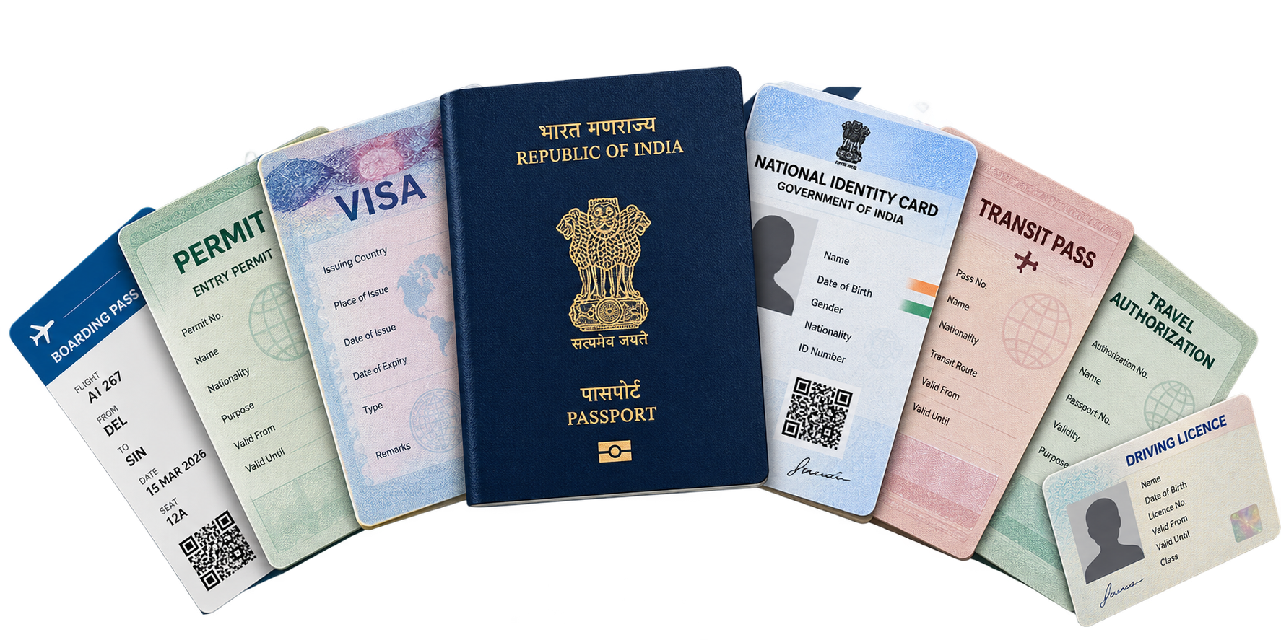
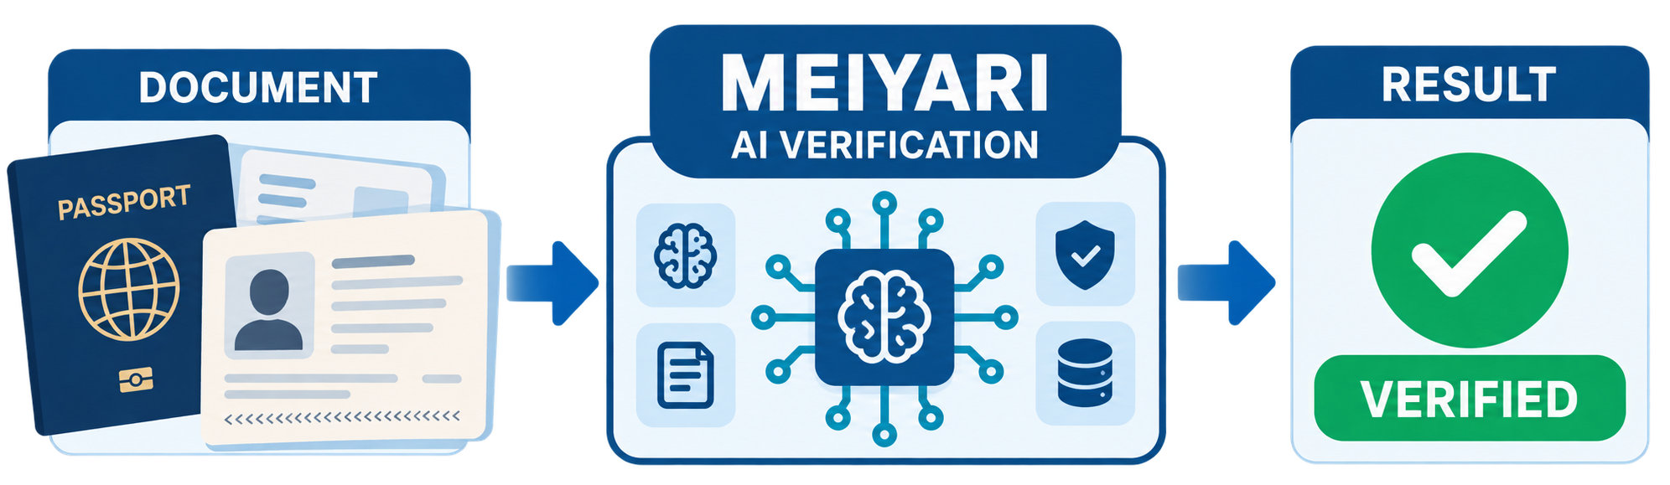
MEIYARI
Tech
Scale
Problem Statement Title: Al-Based Fake Identity & Document Screening System
1. WHAT WE BUILD
2. HOW IT SOLVES THE PROBLEM
3. WHY IT IS UNIQUE
MEIYARI: An AI-powered border verification system that automatically screens and verifies identity and travel documents, detects forgery and tampering, and delivers fast, explainable verification results to authorized officers.
• Automated Verification: AI replaces slow manual screening with rapid multi-level checks.
• Fraud Detection: Detects forged, altered & inconsistent documents.
• Risk-Based Decision: Combines AI, rules & trusted checks into an explainable risk result.
• Investigation Ready: Maintains a tamper-evident trail for later investigation.
ONE-FOR-ALL VERIFICATION
One unified pipeline for multiple identity & travel documents-without separate verification systems for each document type.
EXPLAINABLE AI FORENSICS
Shows where and why a document is suspicious.
MULTI-LAYER FRAUD DETECTION
Checks tampering, inconsistencies, stamps & seals.
“Smarter Verification. Safer Borders.”
-MEIYARI

Slide 3
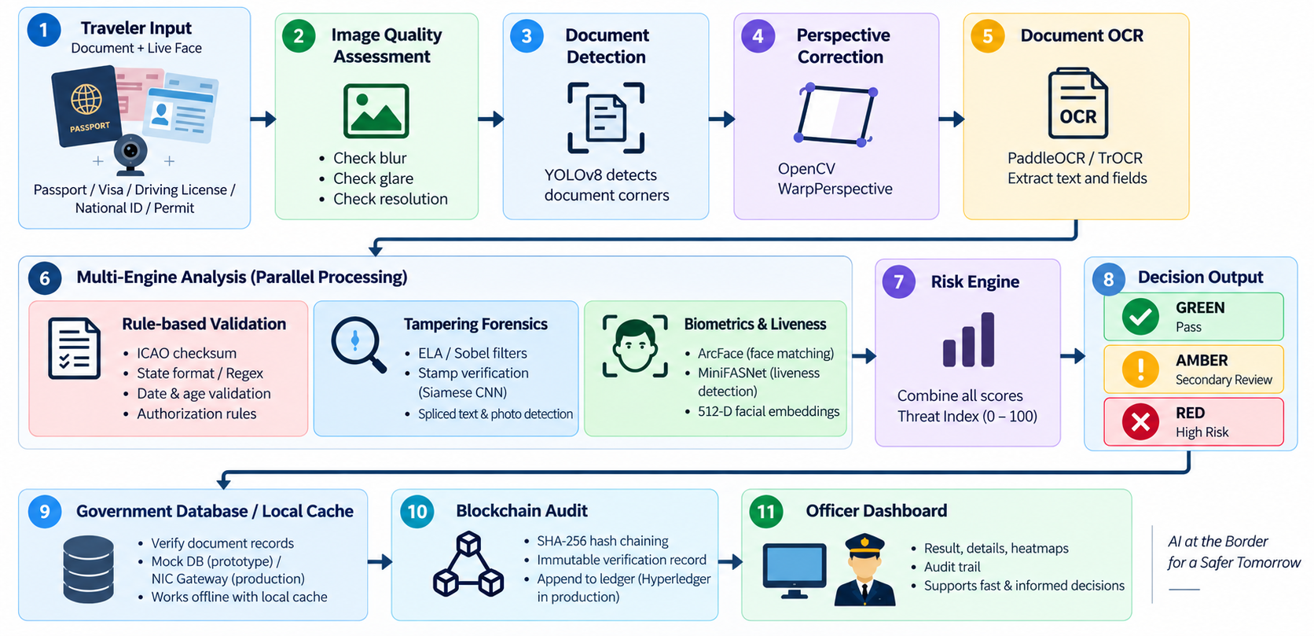
TECHNICAL APPROACHS
Tech
Scale
TECH STACK
WORK FLOW
KIOSK / APPLICATION
React.js
Tailwind CSS
VERIFICATION ENGINE
Python + FastAPI
OpenCV
PaddleOCR / TrOCR
YOLOv8-Nano
ArcFace
MiniFASNet
GOVERNMENT INTEGRATION
Secure REST / gRPC APIs
Government registry connectivity
SECURITY & AUDIT
SHA-256
Hyperledger Fabric

Slide 4
FEASIBILITY AND VIABILITY
Tech
Scale
FEASIBILITY
POTENTIAL CHALLENGES
OVERCOMING THESE CHALLENGES
• Technical Feasible - Built from mature OCR, computer-vision, ML and API technologies already suited to automated document screening.
• Operational Feasible - Designed as an officer-facing verification system with document scanning, face capture and automated verification.
• Integration Feasible -Secure API adapters to integrate with authorized government/registry services where access is available.
• Performance Feasible - Parallel processing enables multiple verification checks to run concurrently, reducing overall screening latency.
Government Registry Access
Authorized APIs + modular adapters
Network / Service Availability
Retry + timeout + Human Review
Poor Document Quality
Quality detection + adaptive preprocessing + recapture
Processing Time
Parallel processing + optimized ML inference
Biometric Reliability
Confidence thresholds + human review

Slide 5

IMPACT AND BENEFITS
Tech
Scale
Potential Impact on Target Audience
Benefits of the solution
Social
Consistent border screening and smoother verification processing.
Officers
Reduces repetitive manual checks and supports evidence-backed decisions in lesser time.
Economic
Increases traveler-processing capacity at existing checkpoints by reducing the time spent on repetitive verification tasks.
People / Travelers
Genuine people /travelers can move through checkpoints with fewer repeated checks.
Security
Multi-signal fraud detection across documents, biometrics and trusted records.
Government
Standardized verification workflow with traceable decision history across checkpoints.
Governance
Tamper-evident verification history for accountability and investigation.

Slide 6
RESEARCH AND REFERENCES
Tech
Scale
ICAO Doc 9303
https://www.icao.int/publications/documents/9303_p1_cons_en.pdf
ArcFace, Deng et al.
https://openaccess.thecvf.com/content_CVPR_2019/html/Deng_ArcFace_Additive_Angular_Margin_Loss_for_Deep_Face_Recognition_CVPR_2019_paper.html
TruFor, Guillaro et al.
https://openaccess.thecvf.com/content/CVPR2023/html/Guillaro_TruFor_Leveraging_All-Round_Clues_for_Trustworthy_Image_Forgery_Detection_and_CVPR_2023_paper.html
PaddleOCR
https://github.com/PaddlePaddle/PaddleOCR
DocTamper Benchmark
https://github.com/qcf-568/DocTamper
CASIA Tampering Dataset
https://github.com/yinanhe/CAISA2.0
Smart India Hackathon
https://www.sih.gov.in/

